Slide 1
Memory Usage Insight
Voyager
2022-01-14

Slide 2
Agenda
What happened
Actions
Next

Slide 3


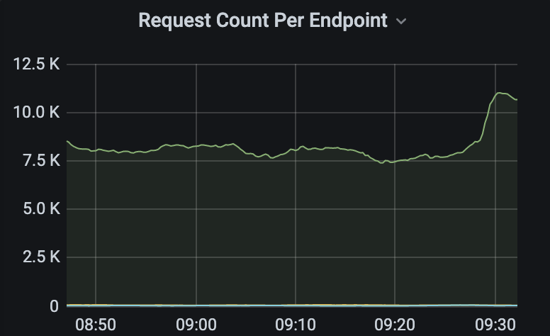
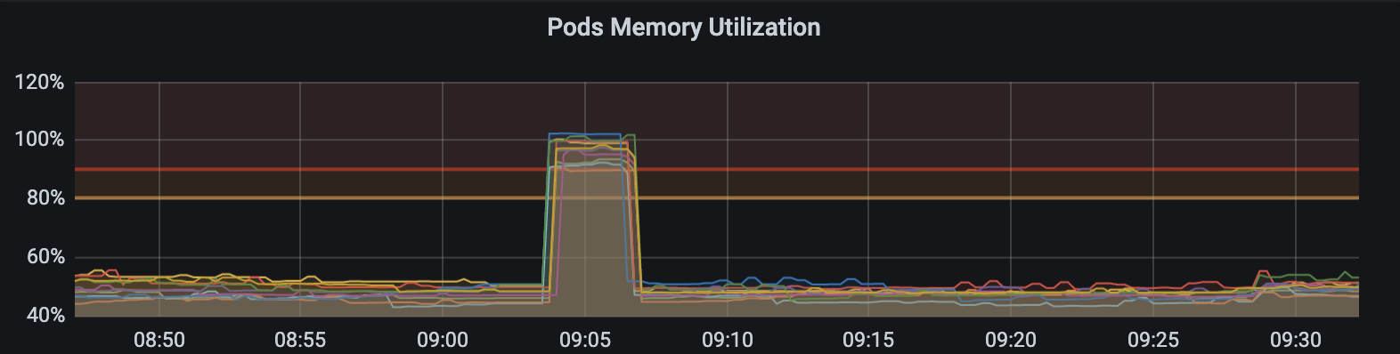

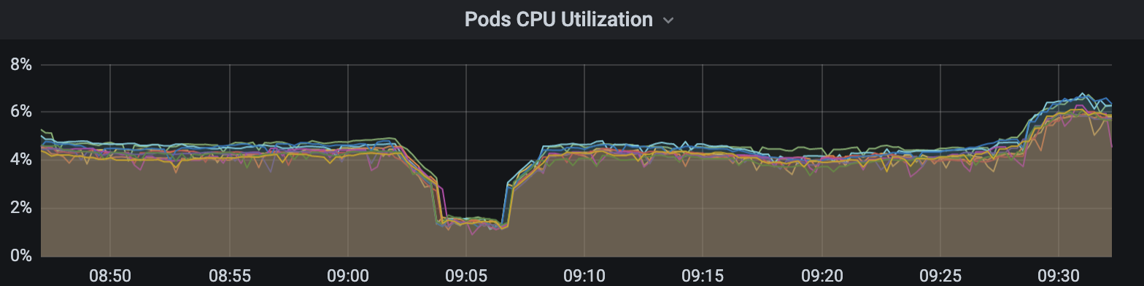


What happened

Slide 4

Action 1 Code Inspection

Slide 5
Action 2 Performance
Use HttpCompletionOption. ResponseHeadersRead when sending request
Use stream when deserialized to object
Build Bulk Subscriptions Endpoint
Decrease the HPA threshold of memory

Slide 6
Action 3 Business
Remove the features part of the payload

Slide 7
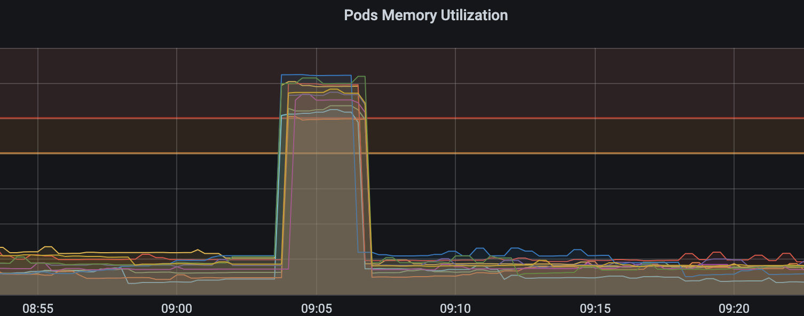
Action 4 Perception

Slide 8
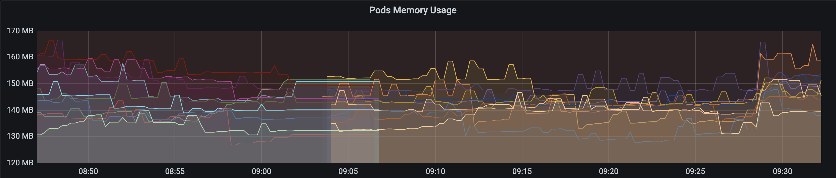
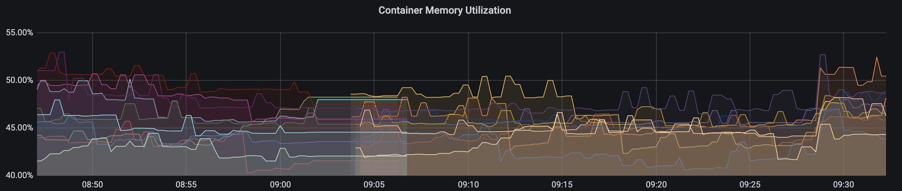
PromQL Expression
container_memory_working_set_bytes: Current working set(byte)
container_spec_memory_limit_bytes: Memory limit for the container(byte)

Slide 9
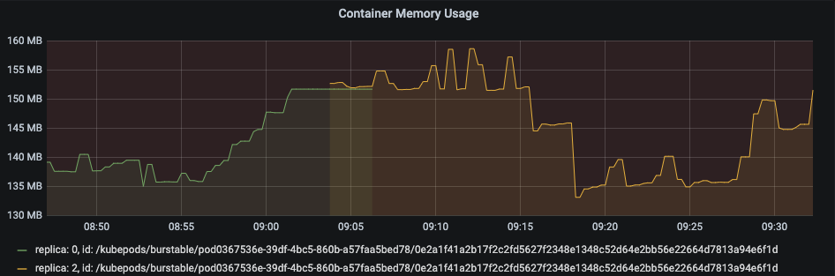
One Container Two TimeSeries
No
Pod/Container
Restart
sum(
container_memory_working_set_bytes{…} / container_spec_memory_limit_bytes{…} )
by (pod_name) * 100

Slide 10
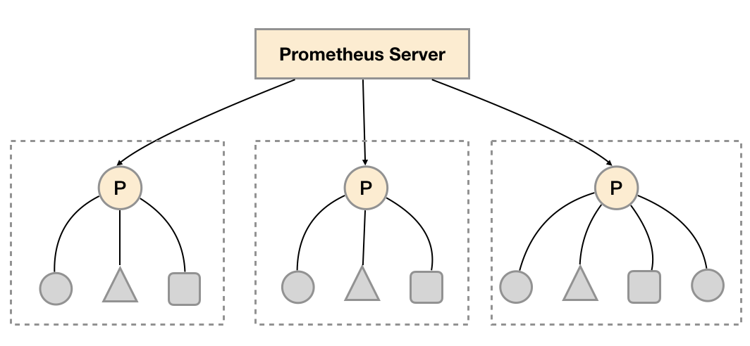
Prometheus Federation & Staleness
Staleness will not be marked for time series that have timestamps included in their scrapes. Only the 5 minute threshold will be applied in that case.

Slide 11
Incorrect Expression
C1
C2
Pod Usage: 80 + 90 = 170MB
Pod Limit: 100 + 200 = 300MB
Pod Utilization: 56%
Memory Usage: 80MB
Memory Limit: 100MB
Memory Utilization: 80%
Memory Usage: 90MB
Memory Limit: 200MB
Memory Utilization: 45%
sum(
container_memory_working_set_bytes{…} / container_spec_memory_limit_bytes{…} )
by (pod_name) * 100
Pod Utilization:
80% + 45% = 125%

Slide 12
Solutions
sum(
container_memory_working_set_bytes{…} / container_spec_memory_limit_bytes{…} )
by (pod_name) * 100
sum-Container
max(
container_memory_working_set_bytes{…} / container_spec_memory_limit_bytes{…} )
by (pod_name) * 100
Show the max memory utilization of the container
max-Container
sum(container_memory_working_set_bytes{…} by (pod_name)) / sum(container_spec_memory_limit_bytes{…} by (pod_name))
* 100
Show the accurate memory utilization of the POD
avg-Pod

Slide 13
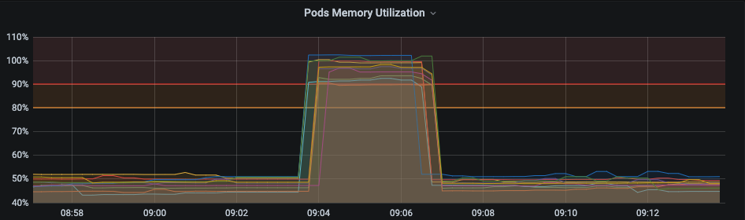
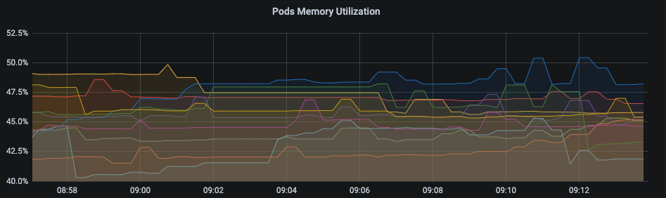
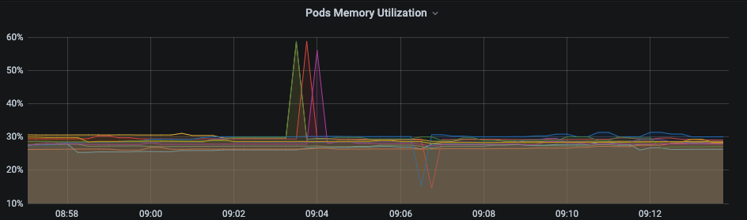
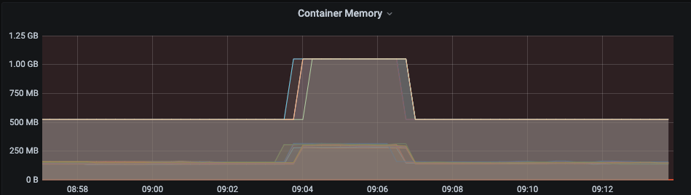
Results
sum-Container
max-Container
avg-Pod

Slide 14
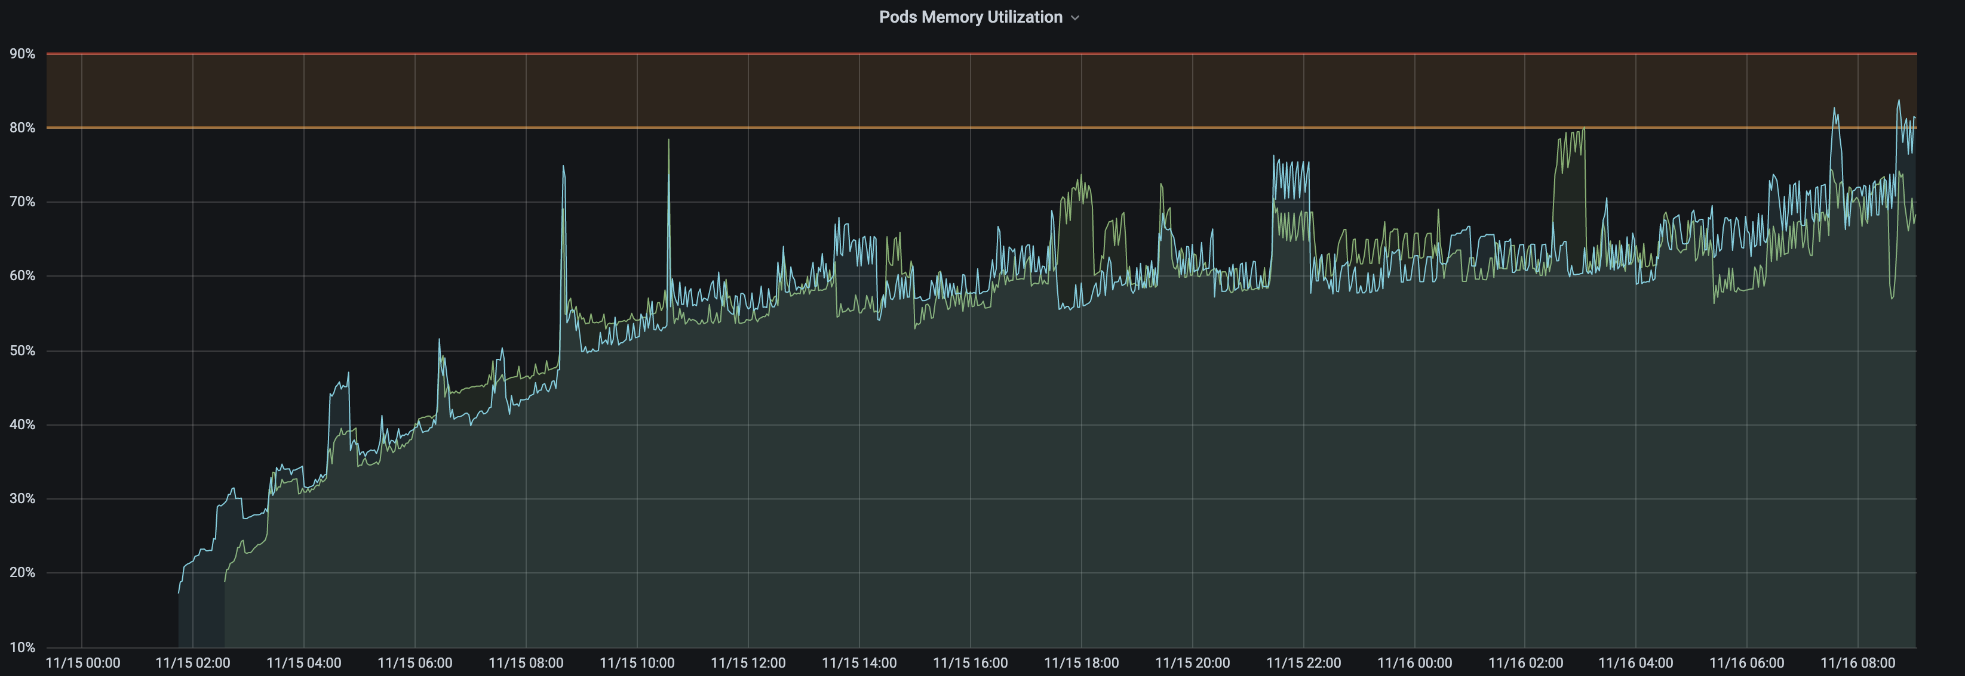
Memory Issue

Slide 15
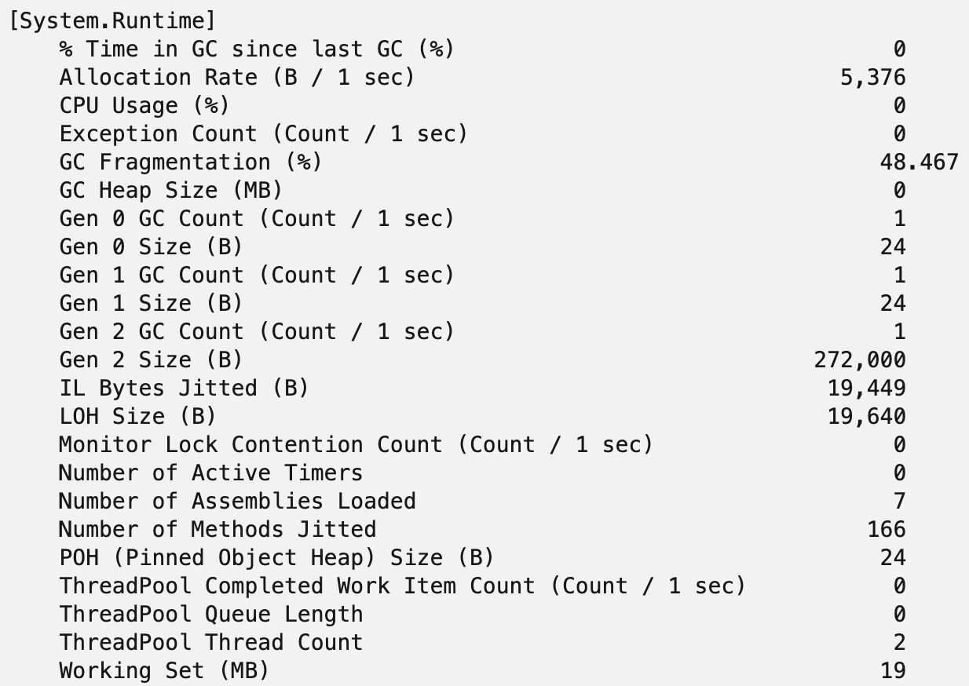
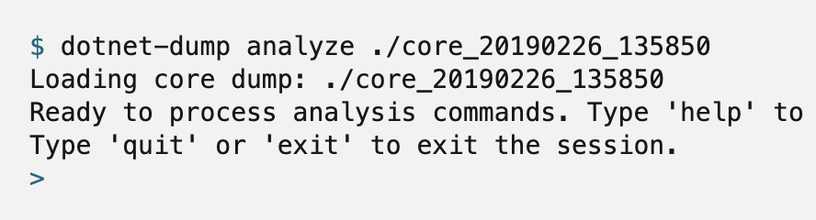
Diagnostic Tools
dotnet-counters
dotnet-counters ps
dotnet-counters monitor –p 1902
dotnet-dump
dotnet-dump collect –p 1902
dotnet-dump analyze ./core_20190226_135850

Slide 16
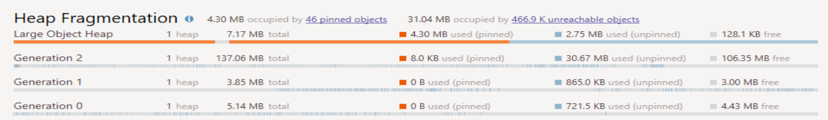
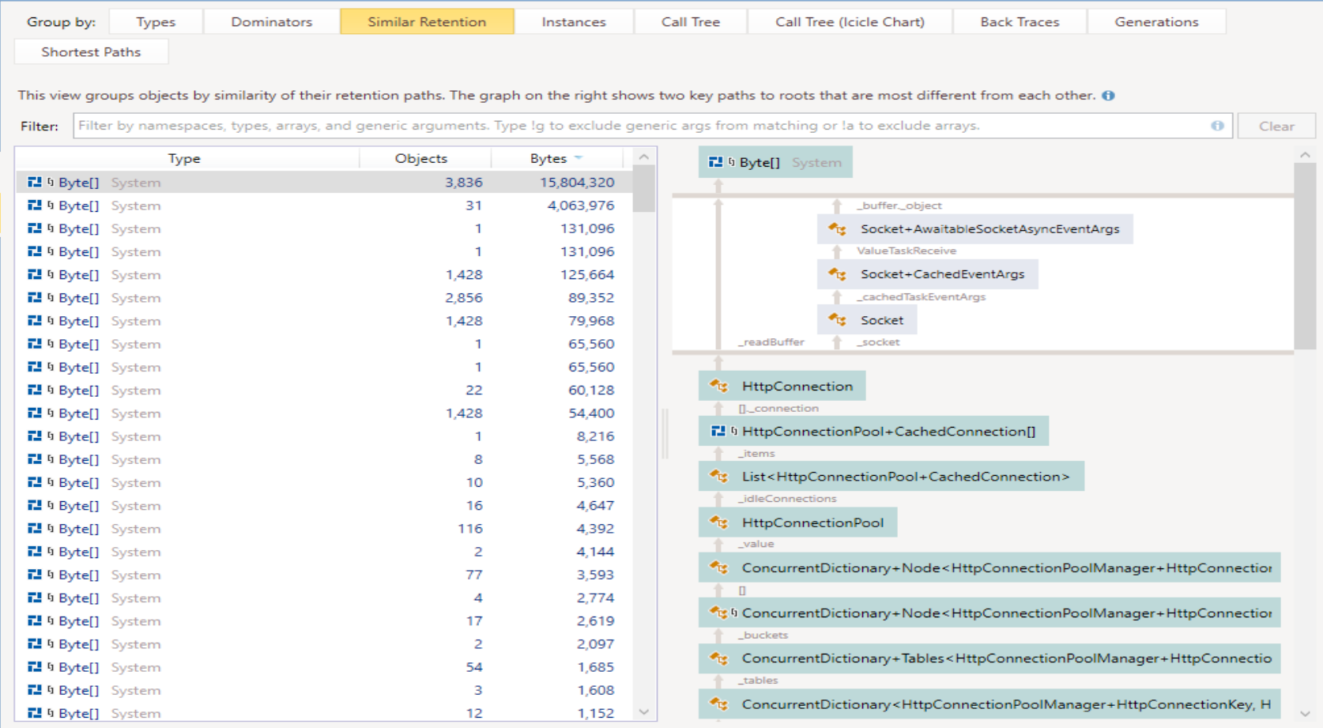
Diagnostic Result

Slide 17
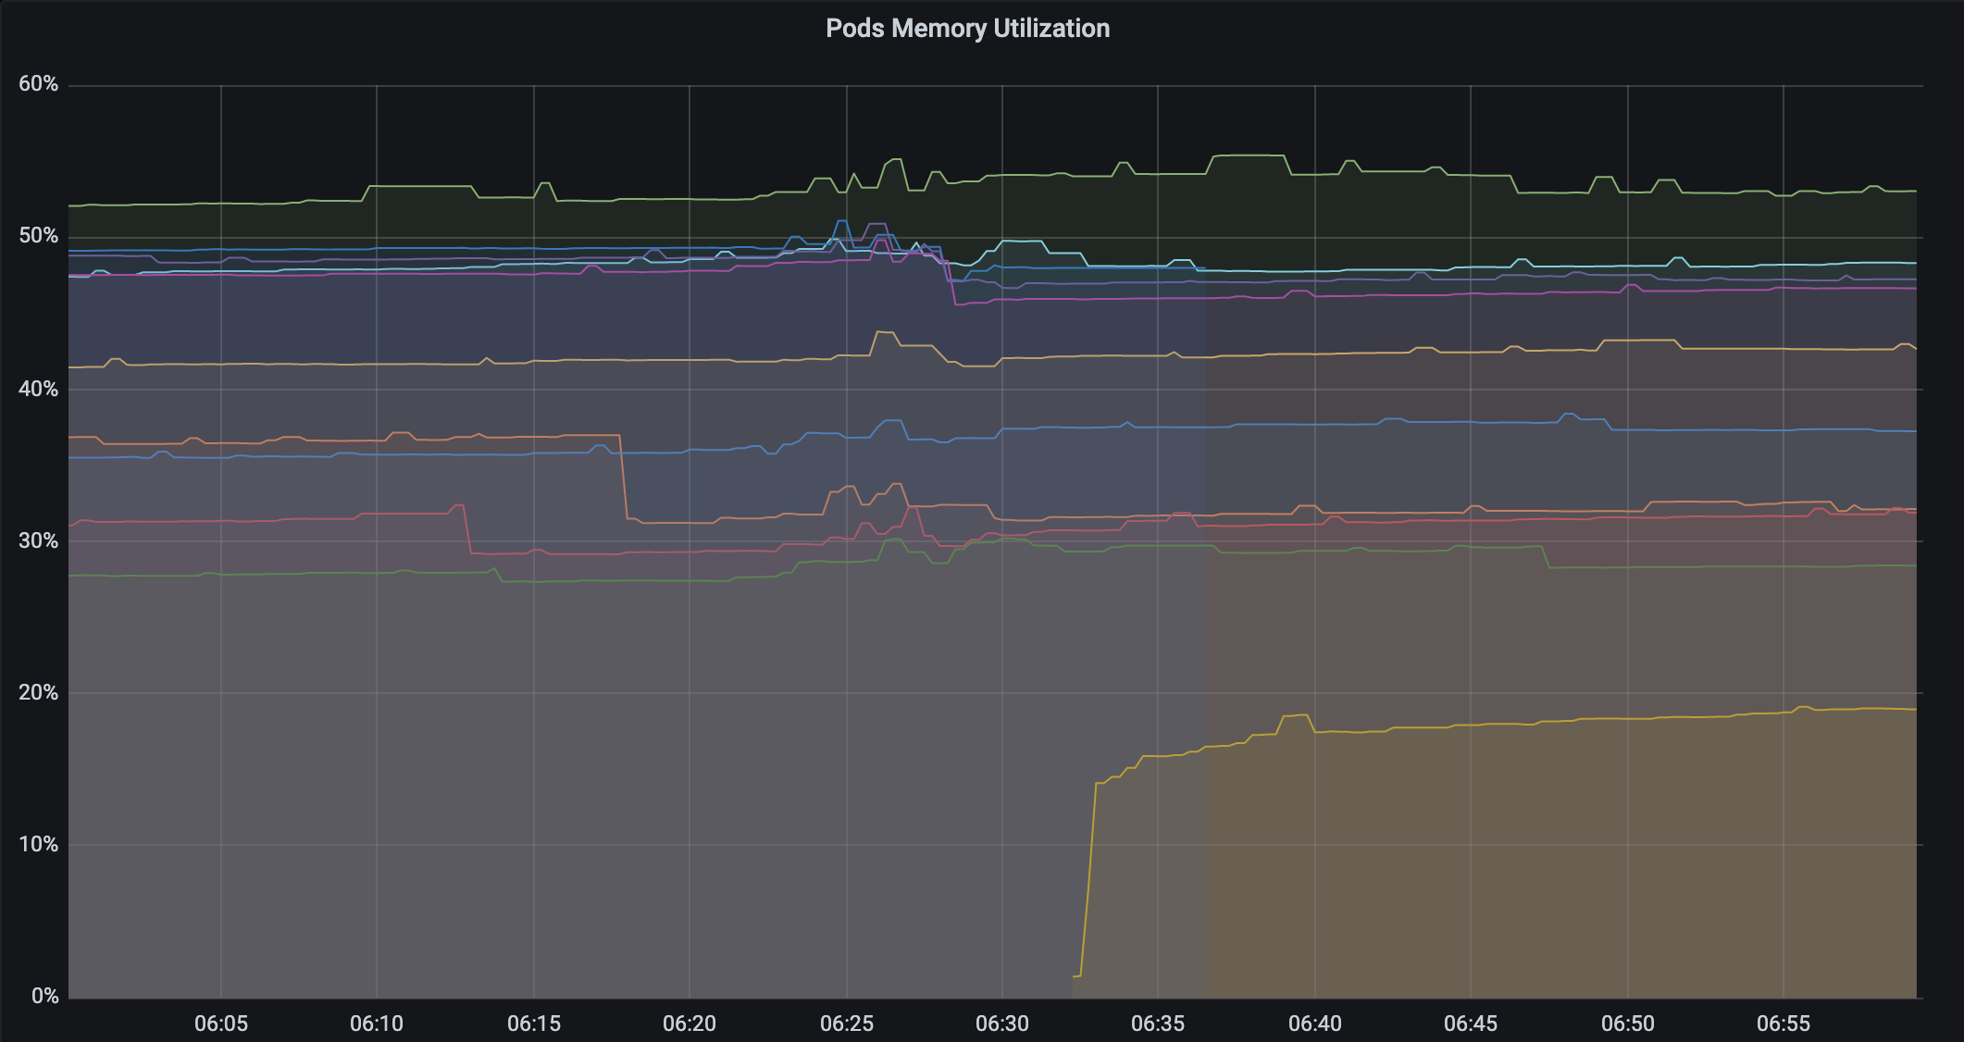
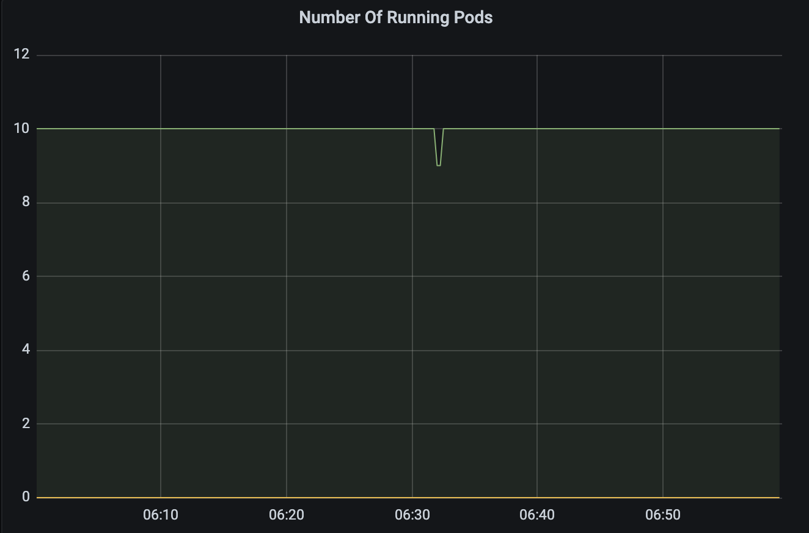
Next
Pod Restart

Slide 18
summary
Do not just copy & paste.
Do not guess, measure.
Dig into & Challenge.

Slide 19
Thank you

